Slide 1

DESIGN AND ANALYSIS OF ALGORITHMS
Dr. Kashif Ayyub

Slide 2
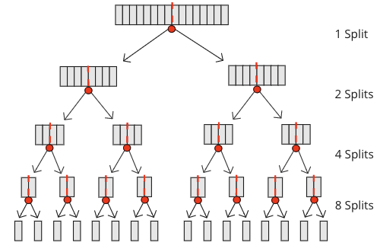
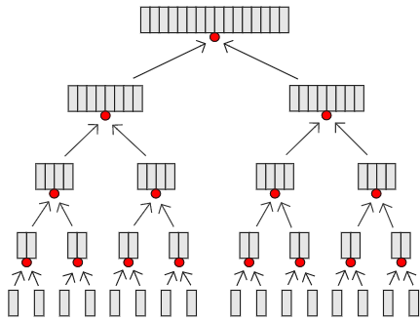
Merge Sort
The Merge Sort algorithm breaks the array down into smaller and smaller pieces.
The array becomes sorted when the sub-arrays are merged back.

Slide 3
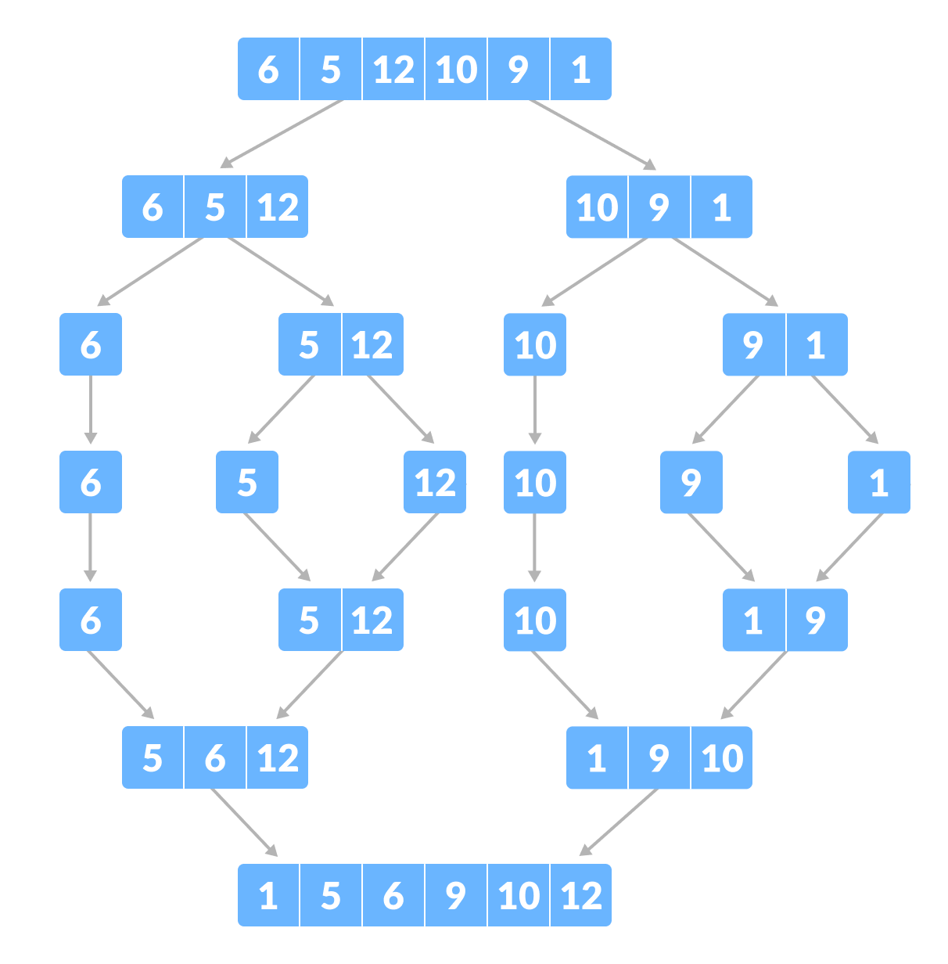
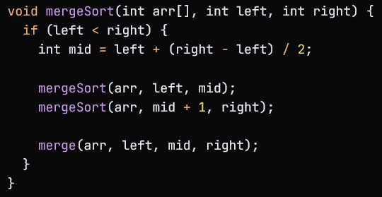
Merge Sort - Example

Slide 4
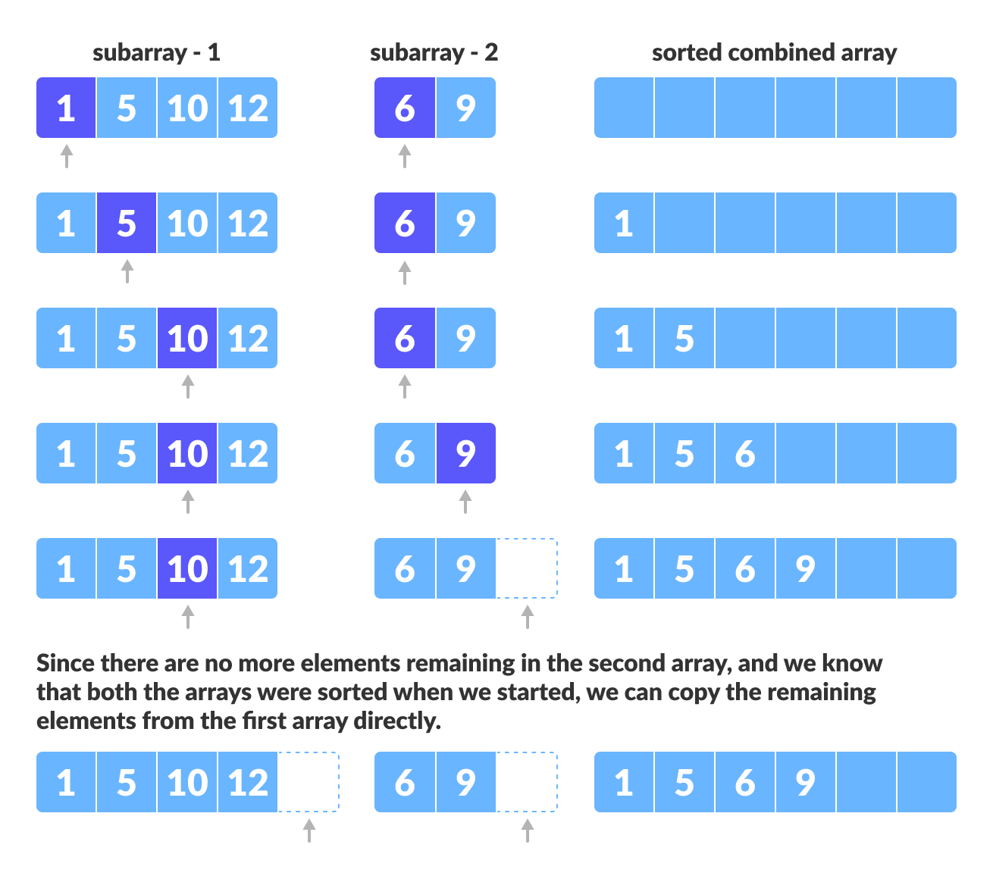
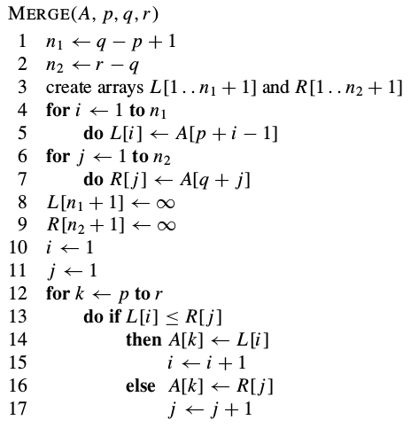
Merge Sort – MERGE Function

Slide 5
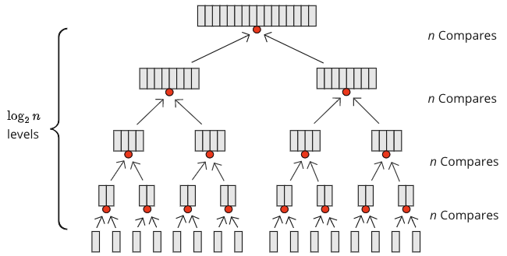

Merge Sort – Time Complexity
As we can see from the figure below, $n$ comparisons are needed on each level.

Slide 6
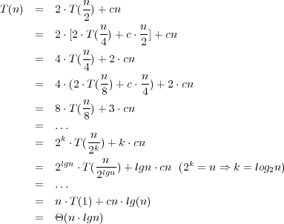
Merge Sort – Time Complexity
The recurrence for merge sort will be:

Slide 7
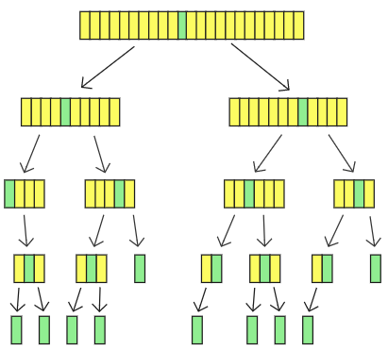
Quick Sort
The Quicksort algorithm chooses a value as the 'pivot' element, and moves the other values so that higher values are on the right of the pivot element, and lower values are on the left of the pivot element.
The Quicksort algorithm then continues to sort the sub-arrays on the left and right side of the pivot element recursively until the array is sorted.

Slide 8
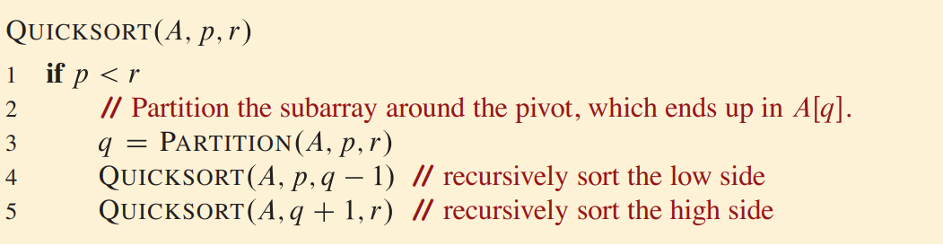
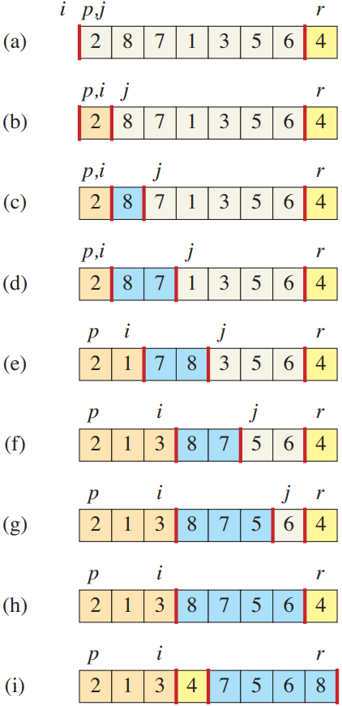
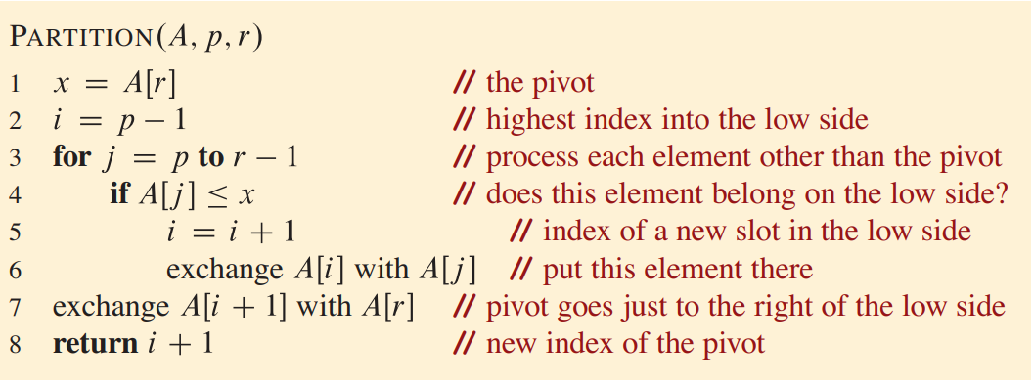
Quick Sort – Working

Slide 9
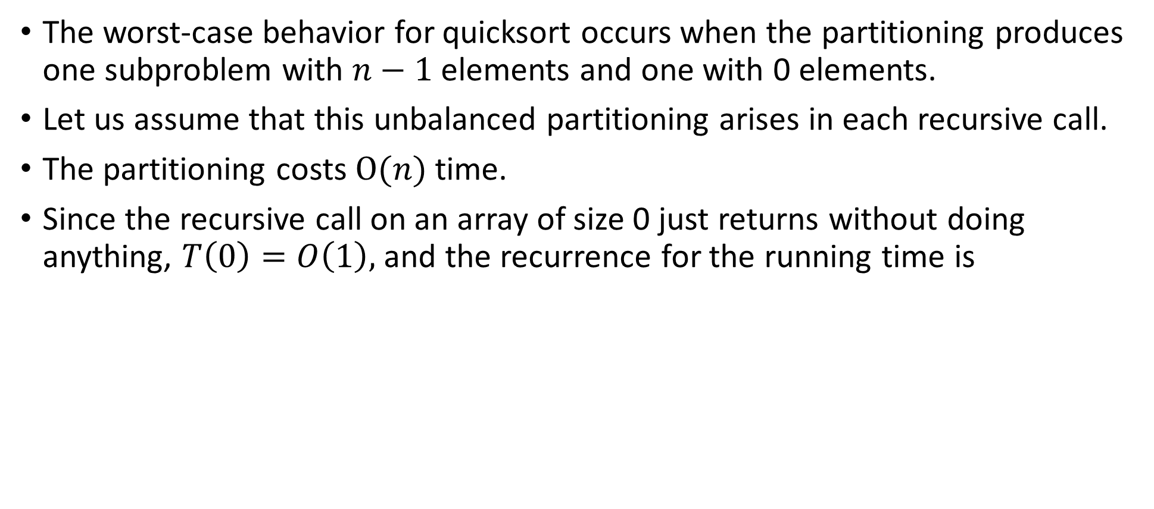


Quick Sort – Time Complexity (Worst-case)
The worst-case behavior for quicksort occurs when the partitioning produces one subproblem with $n−1$ elements and one with 0 elements.
Let us assume that this unbalanced partitioning arises in each recursive call.
The partitioning costs $O(n)$time.
Since the recursive call on an array of size 0 just returns without doing anything, $T\left(0\right)=O\left(1\right),$and the recurrence for the running time is
$$T\left(n\right)=T\left(n−1\right)+T(0)+O(n)$$
$$=T\left(n−1\right)+O(n)$$
$$=O(n^{2})$$

Slide 10
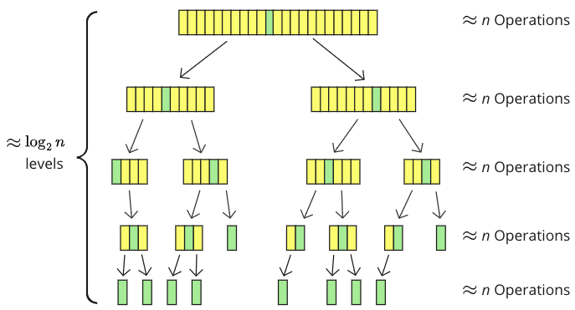

Quick Sort – Time Complexity (Average-case)
Quicksort is fast on average because the array is split approximately in half each time Quicksort runs recursively.
The recurrence for the running time is
$$=O(n^{2})$$

